Slide 1
Analysis on AirBnB listings in New York City
Presented by
Nimya George

Slide 2
Agenda
Objective
Background
Key Findings
Recommendations
Appendix
Data Assumptions
Data Methodology

Slide 3
Objective
Understand key insights from pre-COVID business for NYC neighbourhood.
Improve our strategies to revive our business post-COVID.
Provide recommendation to various departments to be prepared for the changes post pandemic.

Slide 4
Background
For the past few months, Airbnb has seen a major decline in revenue due to pandemic. Revenue took the largest hit in Q2 of 2020 in NYC neighbourhood. Now the travel restrictions have started lifting, Airbnb wants to make sure that it is fully prepared for this change.
So, analysis has been done on a dataset consisting of various Airbnb listings in New York.

Slide 5
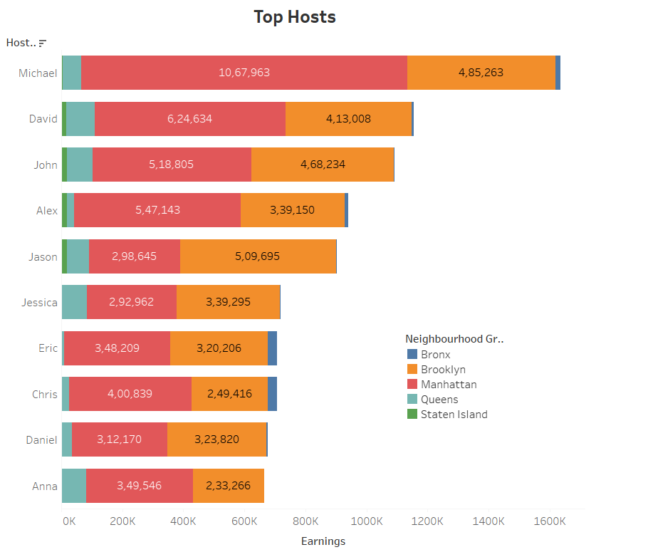
Type of hosts to acquire more.
Michael is the one who acquired more number of hosts and mostly in Manhattan location, followed by David, John, Alex ad Jason.
Other hosts need to acquire more guests to increase the company revenue.
Locations like Manhattan and Brooklyn are the prime locations where people show more interest even though they are very costlier.

Slide 6
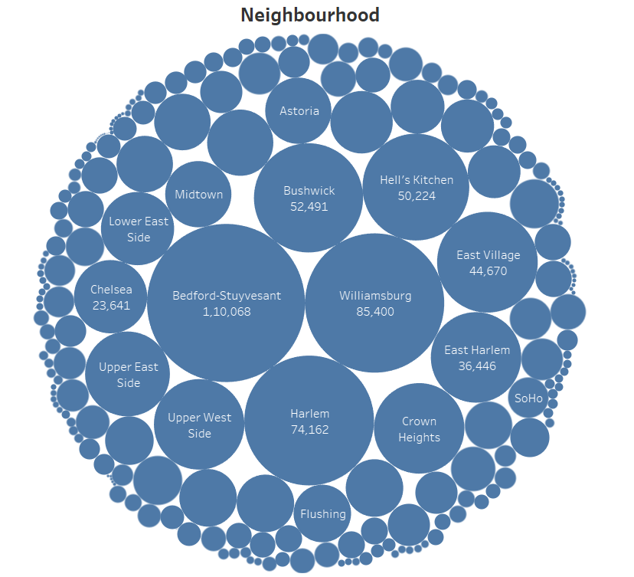
Neighborhoods based on customer preferences.
More than 1 lakhs of customers prefer Bedford-Stuyvesant neighbourhood for their stay.
People also show more interest in Williamsburg, Harlem, Bushwick, Hell's Kitchen etc.. All having preference count of more than 50k.

Slide 7
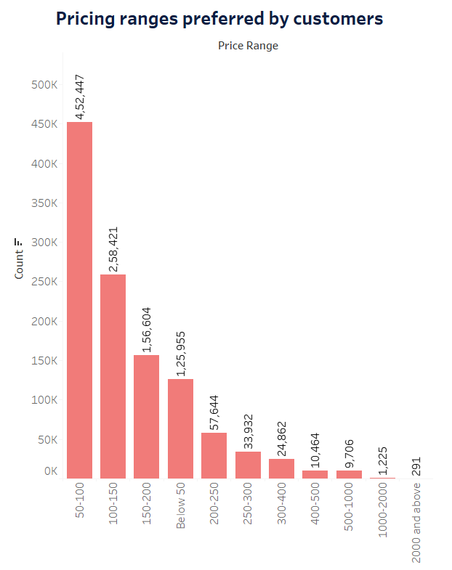
Pricing ranges preferred by customers.
80% of the customers prefer a price range of 50 – 200$
Among this, more than 4 lakhs of people choose a range of 50 – 100$. Majority goes for this range.
Focussing on 50 -100 range can be a way to increase the company revenue.

Slide 8
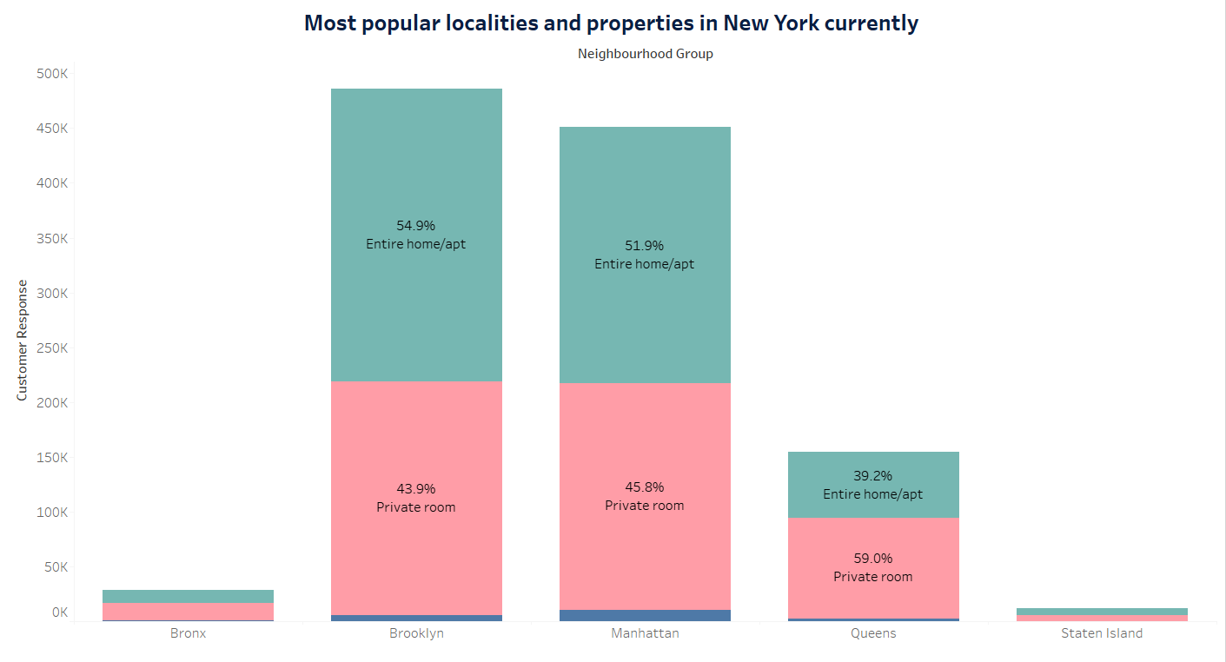
Most popular localities and properties in New York city.
Manhattan and Brooklyn are the top leading locations in the room listings and majority of people like the entire home/Private room.
Price of accommodation in Manhattan and Brooklyn is pretty higher.
Among the 3 types of rooms in which majority of people like the entire home/apartment and private rooms.

Slide 9
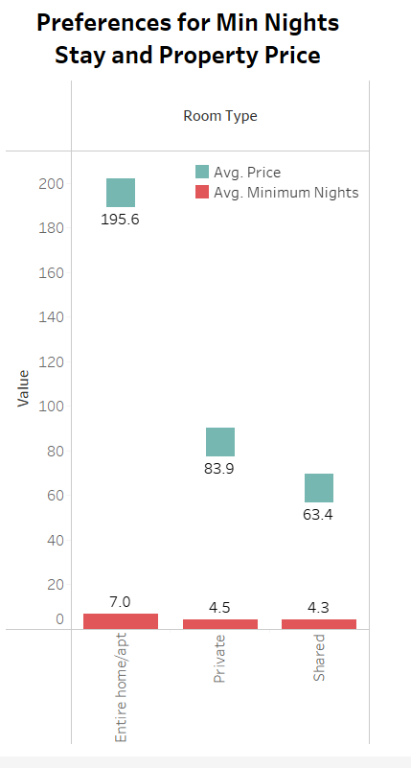
Preferences for Min Nights Stay and Property Price.
Even though the price of the entire home/apartment is very high , the customers like to stay there on more days.
Properties with higher number of nights stay and higher price have got fewer reviews.

Slide 10
What are the adjustments need to do in the existing properties to make it more customer-oriented ?
Should focus more on prime locations such as Manhattan and Brooklyn. Also areas such as Bedford-Stuyvesant, Williamsburg, Harlem, Bushwick etc. Try to improve the customer services and room availabilities there.
Provide more listings of price range 50-200$.
Provide more room types such as entire home/apartment and private rooms mainly in the prime locations and areas.
The post-pandemic time will have a major importance on safety and cleanliness. Operations team have to work on new ways for maintaining and strengthen hygiene standards.
Because of the financial crisis due to pandemic, chances of selecting higher price listings is low. So consider to provide discounts in price for first 2 months, thereby we can attract more people.

Slide 11
How to get unpopular properties more traction?
Give more offers or discounts on price of unpopular ones mainly in less interested places.
Focus more on marketing side.
Work on innovative ways for maintaining and strengthen hygiene standards there.
Proper customer services.
Take measure of your customer service performance.
Run loyalty programs.

Slide 12
Appendix
Data Assumptions
We assumed that core objective of the company is revenue hike.
We assumed that data prior to COVID was achieving the desired revenue. So the main cause for the decline in revenue is due to pandemic
Company tries to comes out with innovative strategies with an assumption that the travel restrictions will lift soon
In dataset, we used Reviews per Listing as the popularity measure to get information on customer preferences
Number of reviews assumed to be a metric for finding customer preferences
Null values assumed to have no impact on analysis
Data Methodology
We have used python to clean the dataset
Data visualisation is done using tableau in order to find insights from the given data
Find detailed methodology document - Airbnb CASE STUDY METHODOLOGY.pdf

